Slide 1

Fighting Hate with Machine Learning
Guided By:
Dr. Kusum Kumari Bharti
By:
Ajwad Shaikh
2017333
Manjot Singh
2017330
Kanishk Goyal
2017322

Slide 2
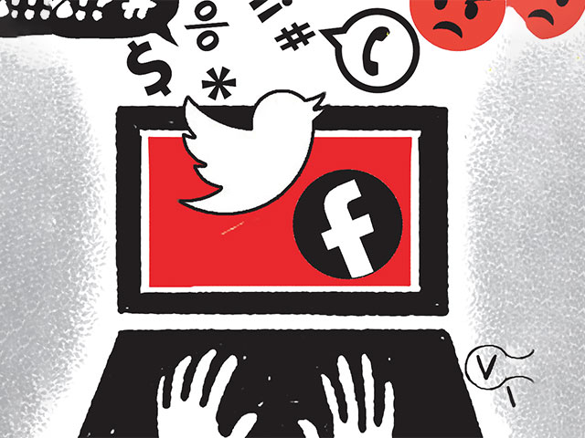
Introduction
Hate has been a political tool in recent years where the majoritarianism has taken over the leaders and inclusive development remains an eye-wash.
Amidst lockdown, the hate speech in social media is spiked exponentially.
Targeted individual is subjected to trolls, rape threats, misogyny and even death threats resulting in mental torture.

Slide 3

Methodology
A number of platform use manual flagging of content to determine weather the content violates their ill-framed policies.
A tool must hence must be developed to help a user ‘set their boundaries’ and create a custom classifier for each user.

Slide 4
Literature
We have reviewed this paper so far on the subject of our project
Implementation Of Naive Bayes Classifier Algorithm On Social Media (Twitter) To The Teaching Of Indonesian Hate Speech ( 2017 International Conference on Sustainable Information Engineering and Technology (SIET) )

Slide 5
Course of Action
Since our methodology aims to create a custom model suited for our users, we should go with Naïve Bayes Model as it is easy to calculate and store for reuse.
We are working with twitter since it is not possible to search for posts with Facebook, due to rigid policies.
We will be working on making Twitter a safe place for the users.

